Slide 1
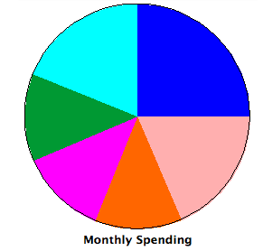
Budget Project
Isabel Teeters
Estes, Core 1
April 20, 2012

Slide 2
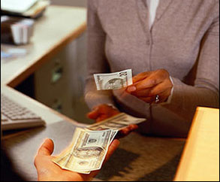
Personal Information:
Name: Isabel Teeters
Occupation: Bank Teller
Training Required: Yes (Kaplan University)
Total Gross Income per year: $35,000
Total Gross Income per month: $2,916.67
Total Net Income per month: $2,070.83
Marital Status: Single
Number of kids: N/A
Kind of pet(s): Dog
Roommates with: Millie Hendrickson

Slide 3
Personal Bills:
Federal Tax: $729.17
Social Security/Medicaid: $116.67
Credit Card: $75
Car (Dodge Neon): $83.34
Gasoline: $90
Pets (Dog): $70
Other (Luxuries/Personal Care): $506.94

Slide 4
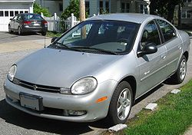
Type of Pet and Car:
Dog: Weiner Dog (Steven)
Car: Dodge Neon

Slide 5
Luxuries/Personal Care Items:
Luxuries:
Personal Care (Multi. By 4):
Xbox 360: $75
Xbox Game (COD: Black Ops): $49.96
Xbox Game (Dead Island): $29.96
Xbox Game (Left 4 Dead 2): $29.96
Xbox Game (Mortal Combat): $16.78
Xbox Game (Assassin’s Creed 2): $19.96
Xbox Game (Final Fantasy XIII): $19.96
Xbox Game (Halo Reach): $39.96
Brita Faucet Filter: $17.88
Plastic Water Bottle: $1.00
Cell-phone: $50
Deodorant: .97
Shampoo: $1.48
Conditioner: $1.48
Bar Soap: $1.00
Razors: $1.00
Shaving Cream: $1.97
Face Scrub: $2.47
Toothpaste: $2.76
Mouthwash: $2.00
Hair Product: $6.00
Makeup: $18.00

Slide 6
Split Bills (What I pay):
Rent/Mortgage: $150
Electric: $15
Cable: $20
Water: $10
Phone: $20
Groceries: $234.04
Remaining: $796.51

Slide 7
7-day Meal Plan:
Sunday:
Breakfast: Orange Juice, Eggs, and Toast.
Lunch: PB&J Sandwich, Apple Juice, and 100 calorie peaches.
Dinner: Steak, Potatoes, Mashed Carrots w/ Butter, and Milk.
Snack: Granola Bar and Water.
Monday:
Breakfast: Pancakes, Bacon, and Tea.
Lunch: Ham & Cheese Sandwich, Cutie (orange), and Grape Juice.
Dinner: Spaghetti w/ Parmesan Cheese, and Milk.
Snack: Twinkie and Water.
Tuesday:
Breakfast: Scrambled Eggs w/ Sausage bits, and Orange Juice.
Lunch: Peanut Butter & Banana Sandwich, Apple Juice, and Baby Carrots.
Dinner: Hamburger Helper and Milk.
Snack: Sour Cream & Onion Chips and Water.

Slide 8
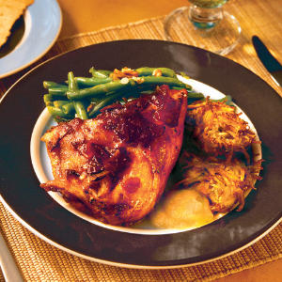
7-day Meal Plan Cont.:
Wednesday:
Breakfast: Cereal and Tea.
Lunch: Yakisoba, Grape Juice, and Cutie (orange).
Dinner: Roasted Chicken, Milk, and Potatoes.
Snack: Apple slices w/ Peanut Butter and Water.
Thursday:
Breakfast: Pancakes, Bacon, and Tea.
Lunch: Ham & Cheese Sandwich, Apple Juice, and Yogurt.
Dinner: Stir-fry and Milk.
Snack: Twinkie and Water.

Slide 9
7-day Meal Plan Cont.:
Friday:
Breakfast: Frozen Sausage Biscuit, Orange juice, and Cutie (orange).
Lunch: Yakisoba, Cantaloupe, and Grape Juice.
Dinner: Chicken Chunky Soup and Milk.
Snack: Granola Bar and Water.
Saturday:
Breakfast: Eggs, Toast, Bacon, and Tea.
Lunch: Peanut Butter & Banana Sandwich, Cantaloupe, and Apple Juice.
Dinner: Steak, Potatoes, and Milk.
Snack: Yogurt and Water.

Slide 10
Grocery List:
Orange Juice (Frozen)- $1.42
Eggs- $2.78
Ham (Deli)- $2.99
Cheese- $2.98
Bread (Wheat)- $1.59
Spaghetti Noodles- $1.00
Spaghetti Sauce (2)- .94 ea.
Parmesan Cheese- $2.64
Baby Carrots- $1.79
Bisquick- $2.72
Maple Syrup- $1.48
Butter- $1.48
Steak (4pk.)- $4.09
Potatoes- $3.47
Cereal- $2.68
Milk- $3.79
Peanut Butter- $2.68
Jelly- $1.00
Hamburger Helper- $1.00
Apple Juice- $1.12
Grape Juice- $1.66
Corn (Frozen)- .98
Hamburger Meat- $3.18
Apples- $2.99
Bananas- .56/lb
Tea (Hot)- $1.00
Rice- $1.28
Stir-fry Meat (Pork)- $4.66
Stir-fry Veggies- $1.98
Bacon- 2.99
Stir-fry Sauce- $1.00
Cantaloupe- .98
Cuties (Bundle)- $1.25
Chicken- $6.10
Frozen Sausage Biscuit (Box)- $3.98
Yogurt (2)- 3 for .99
Twinkies - $2.28
Sour Cream and Onion Chips- .98
Granola Bars- $2.98
Oil- $2.78
Yakisoba- .78 ea.
100 Calorie Peaches (4)- .98 ea.

Slide 11
Spreadsheet:
Bills | Cost | Degrees | Percent
Federal Tax | $729.17 | 90 | 25%
Social Sec./Med. | $116.67 | 14.40 | 4%
Rent/Mortgage | $150 | 18.51 | 5.14%
Electric | $15 | 1.85 | .51%
Cable | $20 | 2.47 | .69%
Water | $10 | 1.23 | .34%
Phone | $20 | 2.47 | .69%
Credit card | $75 | 9.26 | 2.57%
Groceries | $234.04 | 28.89 | 8.02%
Car | $83.34 | 10.29 | 2.86%
Gasoline | $90 | 11.11 | 3.09%
Pets | $70 | 8.64 | 2.40%
Other | $506.94 | 62.57 | 17.39%
Remaining | $796.51 | 98.25 | 27.31%
Total | $2,916.67 | 359.94 | 97.60%

Slide 12
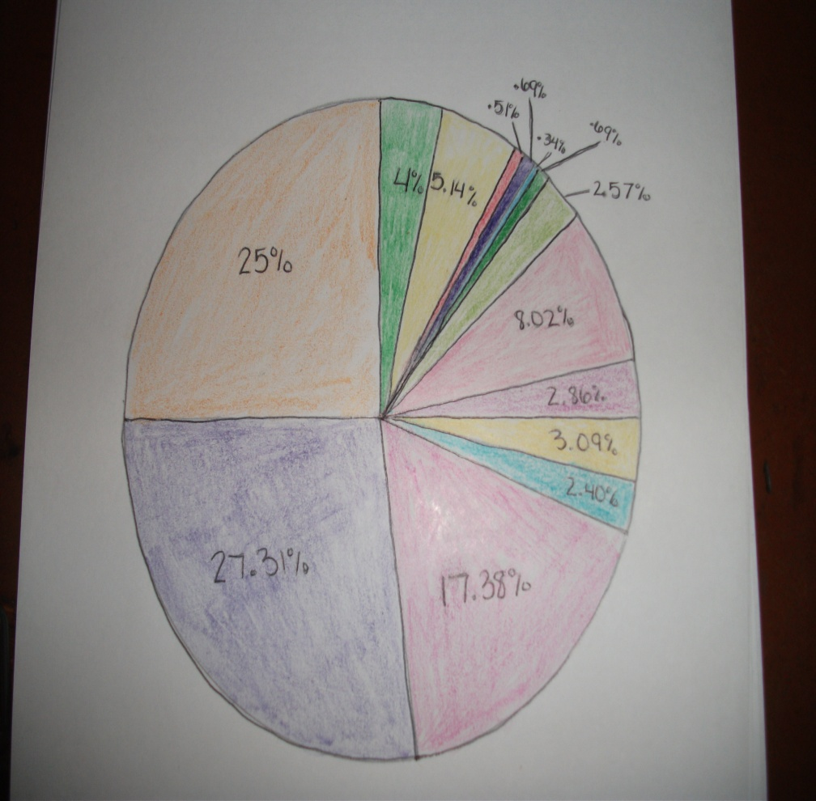
My Spendings:
Orange: Federal Tax
Med. Green: Social Sec./Medicaid
Light Yellow: Rent/Mortgage
Red: Electric
Dark Purple: Cable
Light Blue: Water
Dark Green: Phone
Light Green: Credit Card
Baby Pink: Groceries
Cranberry: Car
Med. Yellow: Gasoline
Sky Blue: Pets
Dark Pink: Other
Med. Purple: Remaining

